Slide 1

Code Refactoring and Bug Fixing
Flask Backend Application
VERSION 2.0
Sarthak Agrawal
March 1st, 2024

Slide 2
About me
I am an emerging data scientist who recently competed his Masters in Computer Applications with Specialization in Machine Learning. My educational has always been quite average but I think I possess a quality much needed for a Data Science career which is ability to learn quickly and curiosity. I like to work in my comfort zone but more often than not, I like to challenge myself with tasks that seems to be quite interesting.
I want to learn andd excel in Data Science because of mostly two reasons. First, the field of data science has its connections and usability in almost every field out there and secondly it aligns with my dream of using my skills to work in an automotive company like Koenigsegg where they do use engineering to design world’s fastest cars but also rely on massive amonts of data to make that possible. I want to be the one to dive and get insights from that data and also build complex models that can eliminate the use to drivers in a car to such an extent where it would seem like a norm to have a driverless vehicle and experience that same thrill while riding in the passenger seat.
I have 7 months experince as a Subject Matter Expert (SME) at hexaware technologies where I worked in conjunction with the Analytical team by providing them business information to develop models and drive insights from data to improve the business process and solve real world scenarios of customer problems.
Link to Github Repository : LINK

Slide 3
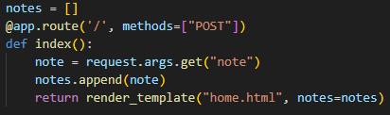
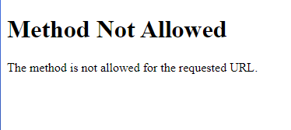
Task Refactor the existing codebase and ensure the proper functioning of the Note Taking Application. Document all identified bugs during the debugging process.
Basic Debugging
Debugging is the process of identifying and fixing errors, or bugs, in software code. It is an essential skill for software developers and involves systematically locating and resolving issues that prevent the code from functioning correctly.
Debugging is an iterative and systematic process that requires patience, attention to detail, and problem-solving skills. By employing a combination of techniques and strategies, developers can effectively identify and resolve bugs, leading to more robust and reliable software.
Bugs in the codebase and their fixes
PROBLEM : The method provided for this route is only ‘POST’ which is a method that is used to submit data to be processed to a specified resource. It sends data in the request body and is commonly used for creating or updating resources on the server. When running the application, the type of request being sent to the route is “GET” but the route currently is only capable of listening to “POST” requests.
Detected an error in the method provided for the ‘/’ route ->

Slide 4

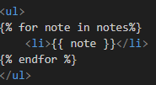
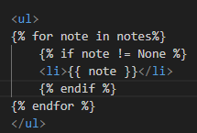



Fix : Since this route is not only adding data to the notes list but also displaying that data on the web page, we shall update the ‘methods’ parameter so that the route can listen to both “GET” and “POST” requests.
Detected an error in the HTML code
Problem : The codebase provided was displaying ‘None’ as an item of the list.
Fix : Using Jinja templating in the HTML code, added a condition that the notes list will only be displayed if the list item is not equal to None i.e. list should not be empty.
Detected an error in the HTML code
Problem : The form tag in the HTML code was not having a “Submit” button to submit details from the client (frontend) to the server (backend).
Fix: Added the “Submit” button.
Quality of Life Change -> The title of the page was “Document”. ,
Changed that to “Note Taking Application”.

Slide 5
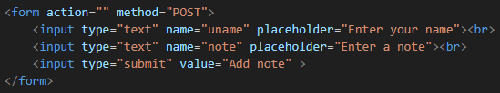
Code Refactoring with Debugging
So now that we have the basic problems, now let’s move on to refactoring the code to better fit the needs of the user, not by beautifying the application but making it more functional. On the way, I encountered more bugs but managed to solve them all (mostly).
Let’s look at the following set of problems to tackle,
Notes on the application are Public and common for all users
PROBLEM
This problem was pointed out to me by our Instructor @Kanav Bansal. So basically what was happening that, if the application were to be deployed, all the users using the application would have been able to see each others notes, making it a huge privacy concern as the notes may contain sensitive information like passwords, financial details etc.
Another problem is that since there is no database connected to the application, there is no way to store and retrieve the notes and even if we store the notes we need to separate them for each user.
FIX
To solve this problem, we created a dictionary to act like the databse. The reason for choosing a dictionary was that since the dictionary has key-pair structure, the idea is to have user names as keys and the respective values of the keys as their notes.
Now since a user of the application may have multiple notes, we need to modify the values of keys from strings -> lists so that it can carry all the data.
As it can be seen from the code snippet that the ‘note’ is not initialized as an empty list. This was done beacuse since the backend is connected to HTML frontend and HTML converts all data to text type, so if the variable were to be initialized as an empty list, HTML will convert it to ‘None’ type making the object not iterable anymore and also providing incorrect note entry.
Since the notes are being added one-by-one, we just need to make the first note list type and then append subsequent notes to the list.
Now since we also need the name of the user, we need to modify the form to also have a name input field for the user to enter their names.

Slide 6


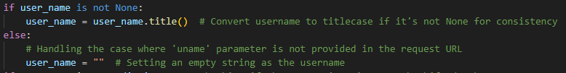
From the previous code snippet, it can be seen that the ‘method’ attribute of the form tag is also set to “POST”, this was done to protect the privacy of the data being sent. Changing the ‘method’ to “POST” will not append the data being sent from the form on the URL, instead the route will directly be handling the data.
For that to happen, a minor change was needed. Instead of “request.args.get()”, we need “request.form.get()”. Doing this will allow the route to directly get the data from the form tag.
Secondary Problem
Doing the above change, brought forth a new problem that, when the application starts for the first time, the
“user_name = request.form.get("uname")” was returning “None” , which in turn was creating a user of name “None” and the application was not rendering this code :
Secondary Problem Fix
To fix the problem we used Jinja Templating in the HTML code where we put a condition to display the message if “user_name” was an empty string.
On the Python side of Code we made sure the “user name” contains empty string if there is “None” returned from
user_name = request.form.get("uname"), and if a proper name is returned, We convert it to titlecase to keep consistency in the data and also so that all names in the dictionary regardless of what case they were entered in are considered to be same as long as the spelling of the name remains the same.

Slide 7
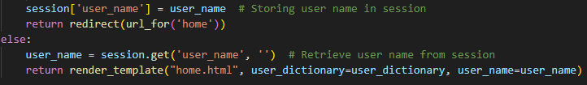
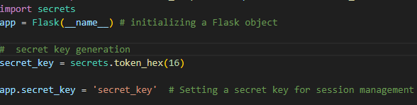
Page refresh adds same note to the existing list of notes
Problem
The problem here is that on refreshing the page, the note that was last entered on the page was getting added to the list of existing notes, creating unwanted duplicate list data.
Duplicate notes are not a problem as long as they are entered by the user, but in this case they are not being entered by the user but coming from the form being resubmitted when page is refreshed.
FIX
To fix this problem, we will try to stop the form from being resubmitted when page is refreshed.
To accomplish that, after submitting the form using “POST”, we will redirect the user to another URL using the redirect function from Flask. This helps prevent the form from being resubmitted when the page is refreshed. In our case since other routes are not allowed as per task description so we will redirect it to the home route “/”.
Also we will use session management to store the form data of user_name temporarily and retrieve it after the redirect happens.
To use sessions and make it secure, we needed secret keys to protect the session, so a new key will be generated every time the server starts for the first time. We generate a 32-character hexadecimal string as the secret key.

Slide 8
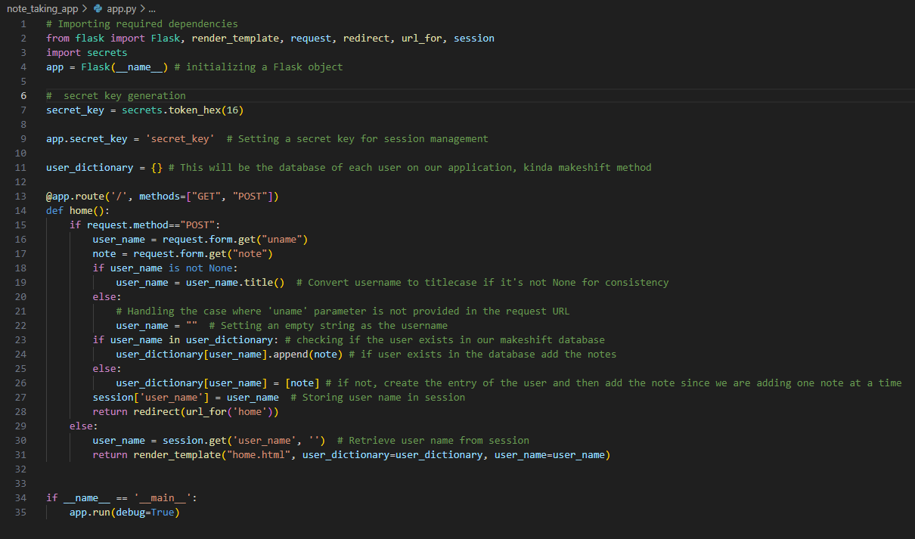
Python Application Code Snippet

Slide 9
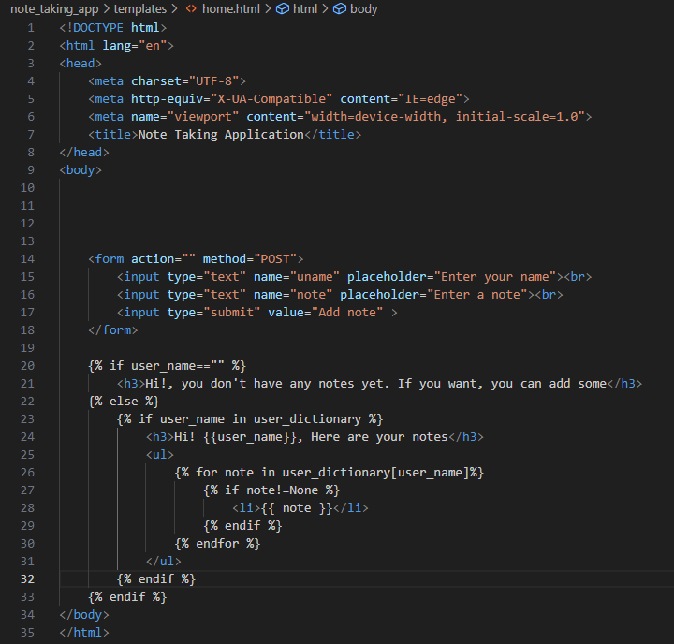
HTML Code Snippet

Slide 10

THANK YOU

